Slide 1
THE WASHINGTON METROPOLITAN AREA TRANSIT AUTHORITY
Pre-Proposal Conference
MTPD Uniforms
Solicitation CQ18105
February 15, 2018
2:00 PM
Bridgette Crowell Monique Anderson
Contract Administrator Contracting Officer

Slide 2
THE WASHINGTON METROPOLITAN AREA TRANSIT AUTHORITY
AGENDA
Safety Tip
Introductions
Housekeeping
Overview of IFB
IFB Requirements
Insurance Requirements
Questions and Answers

Slide 3
THE WASHINGTON METROPOLITAN AREA TRANSIT AUTHORITY
INTRODUCTIONS
Agency Representatives
Department of Procurement
Bridgette Crowell, Contract Administrator
Monique Anderson, Contract Officer
Program Team

Slide 4
THE WASHINGTON METROPOLITAN AREA TRANSIT AUTHORITY
Housekeeping
Restrooms
Sign attendance register
Provide business card
Sign in sheet and a copy of the agenda will be posted on the website: www.wmata.com/MTPDuniform

Slide 5
THE WASHINGTON METROPOLITAN AREA TRANSIT AUTHORITY
Disclaimer
The information contained in this presentation is for informational purposes only.
In the event of a discrepancy between the information contained herein and the IFB documents, the IFB documents will take precedence.

Slide 6
THE WASHINGTON METROPOLITAN AREA TRANSIT AUTHORITY
Pre-Proposal Conference Rules of Conduct
The Pre-proposal conference is for information only. Any answers furnished during the conference will not be official until they have been verified, in writing. All questions, written answers, and any follow up documentation will be posted website as an addendum to, and shall become part of this IFB.

Slide 7
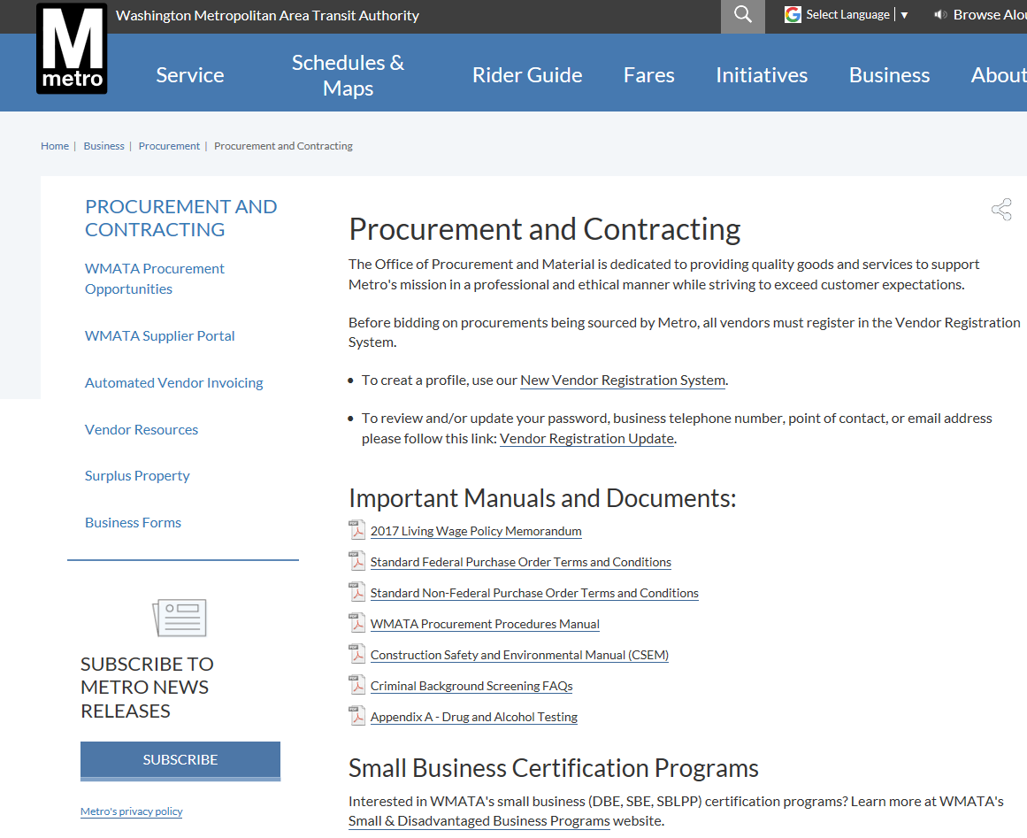
THE WASHINGTON METROPOLITAN AREA TRANSIT AUTHORITY
Supplier Development & Support
Your Gateway to All Procurement Information
Links to:
Vendor Relations
Procurement Handbook

Slide 8
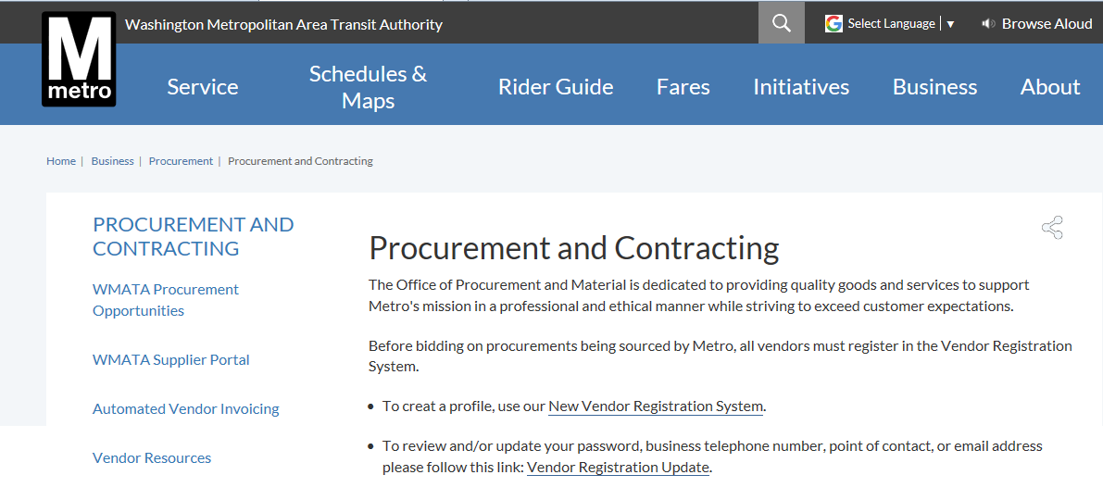
THE WASHINGTON METROPOLITAN AREA TRANSIT AUTHORITY
Supplier Development & Support
Vendor Registration

Slide 9
THE WASHINGTON METROPOLITAN AREA TRANSIT AUTHORITY
Supplier Development & Support
Bridgette Crowell, Contract Administrator
Telephone: 202-962-2718
Email: bcrowell@wmata.com
Monique Anderson, Contracting Officer
Email: mmanderson@wmata.com
Web: https://www.wmata.com/business/procurement/vendor-resources.cfm
Vendor Registration
Email: Procadmin.com

Slide 10
THE WASHINGTON METROPOLITAN AREA TRANSIT AUTHORITY
Proposal Due
Sealed proposal must be received on or before
February 26,2018, 2:00 PM EST to the Issuing Office at the following address:
Washington Metropolitan Area Transit Authority
Office of Procurement
Attn: Bridgette Crowell
600 Fifth Street NW, 3rd Floor
Washington, DC 20001

Slide 11
THE WASHINGTON METROPOLITAN AREA TRANSIT AUTHORITY
Summary of Solicitation
•Procurement Method: IFB
•Performance Period: Two (2) year base periods
•Option Years: Three (3) one year options, exercised at the discretion of the Authority
•Anticipated Contract Award: March 2018
•Contract Type: Requirements
Contractors are encouraged to ask questions or get clarifications during the Q&A period or submit a written questionnaire.
Proposal Package Notes

Slide 12
THE WASHINGTON METROPOLITAN AREA TRANSIT AUTHORITY
Questions & Answers
Answers provided today are considered unofficial and not binding.
All questions and responses will be posted on the Procurement Solicitation Website
Thank-you for attending today’s
Pre-proposal conference

